Slide 1
What is Memory Allocation?
?

Slide 2
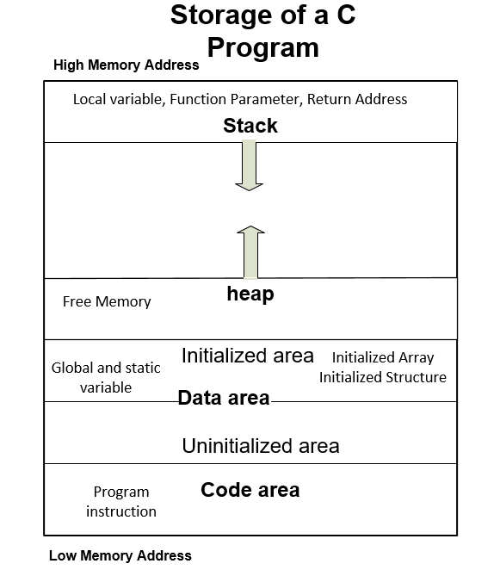
Memory Allocation Process
Data area and code area are permanent storage area. Sizes of both area are defined before execution of the program.
In heap area, memory allocation and deallocation work done by programmers.

Slide 3
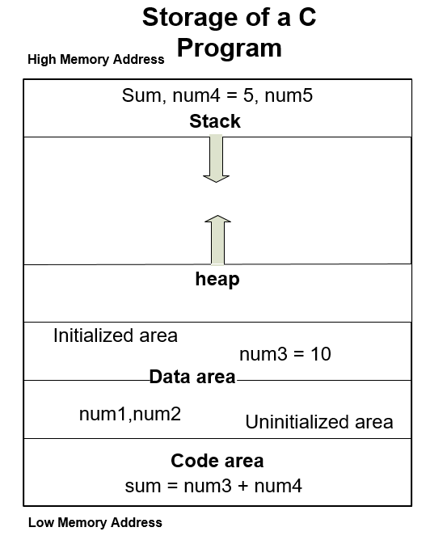
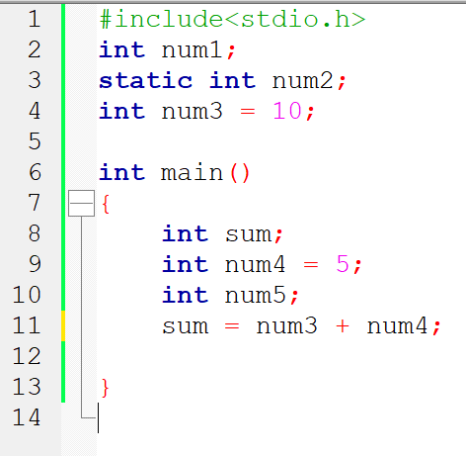
Memory storage example

Slide 4
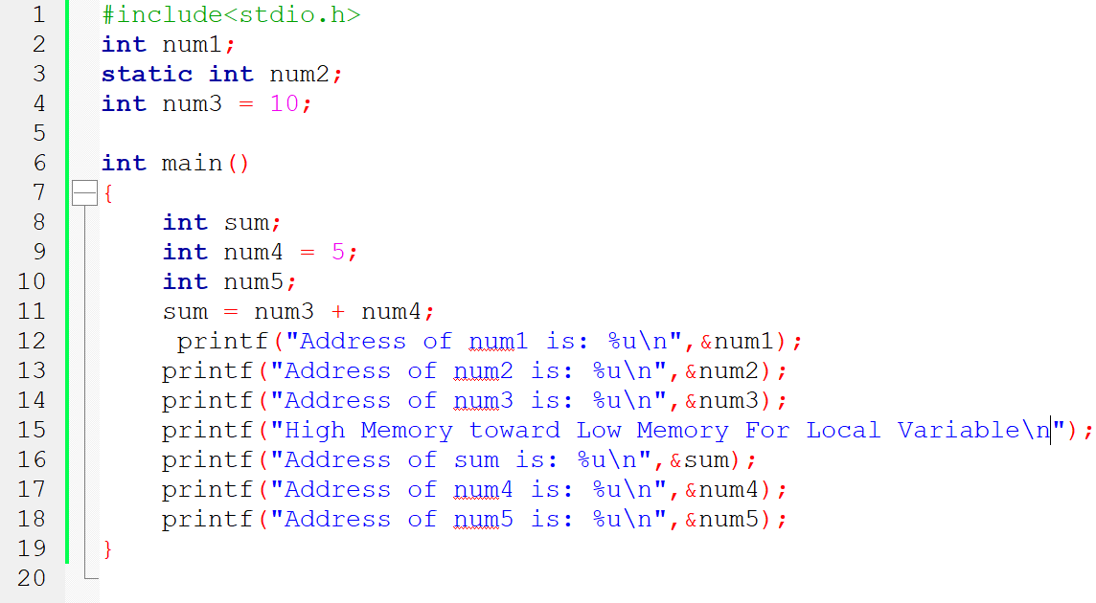
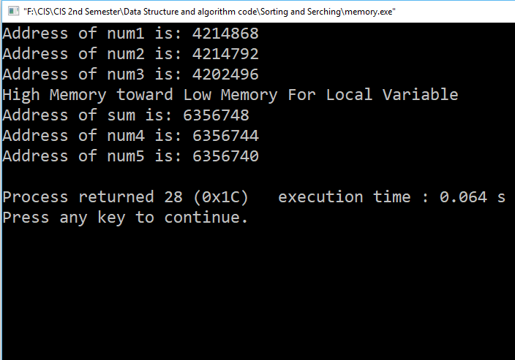
Memory storage example

Slide 5
Run time vs Compile time
Compile time (related to Compiler)
Run time (After compilation of the Program)
What is Dynamic Memory Allocation?
The Process of Allocating Memory at Run time using heap memory. Dynamic memory management refers to manual memory management.

Slide 6
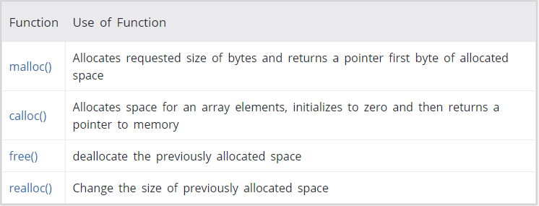
Functions in Dynamic Memory Allocation

Slide 7
Functions in Dynamic Memory Allocation
Header file: stdlib.h
Prototype:
a) malloc() -> void *malloc(size_t size) -> returns void type pointer
b) calloc () -> void *calloc(size_t nitems, size_t size)
c) free() -> void free(void *ptr) -> Deallocated memory block
d) realloc() -> void *realloc(void *ptr, size_t size)
size -> This is the size of memory block in bytes
size_t -> This is the number of elements to be allocated.
nitems -> This is the number of elements to be allocated.

Slide 8
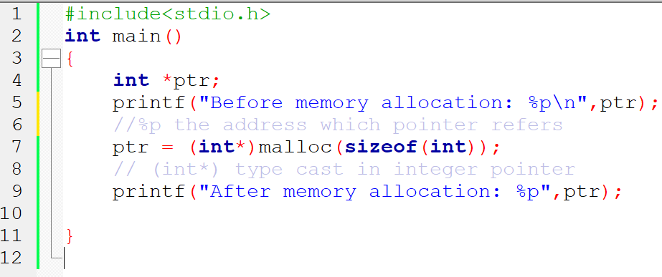
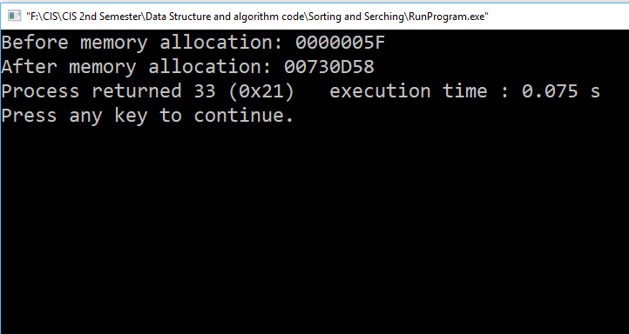
Example of Malloc

Slide 9
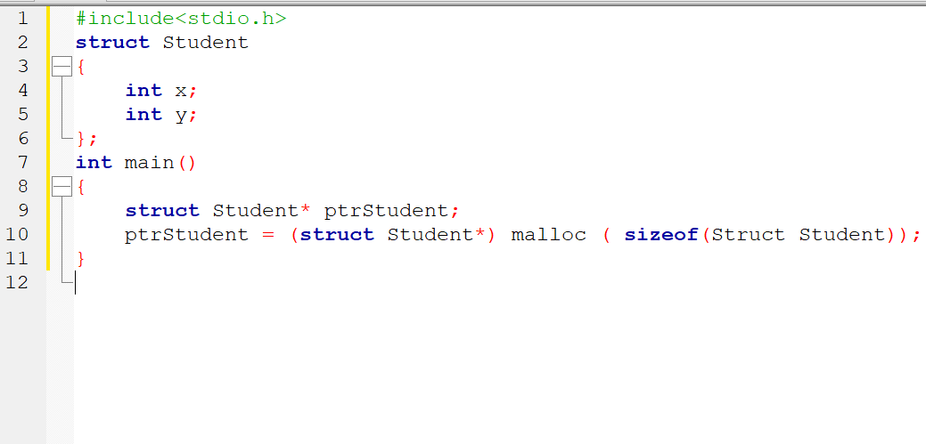
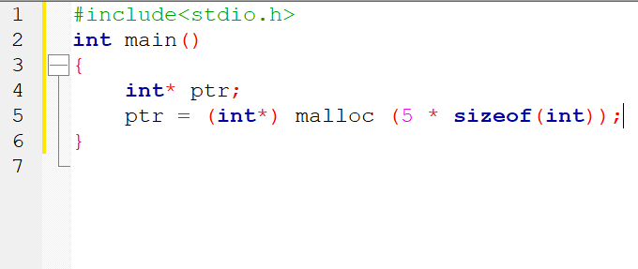
Example of malloc()
malloc() can be used for Array or Custom data type like Structure.
Array using malloc()
Structure using malloc()

Slide 10
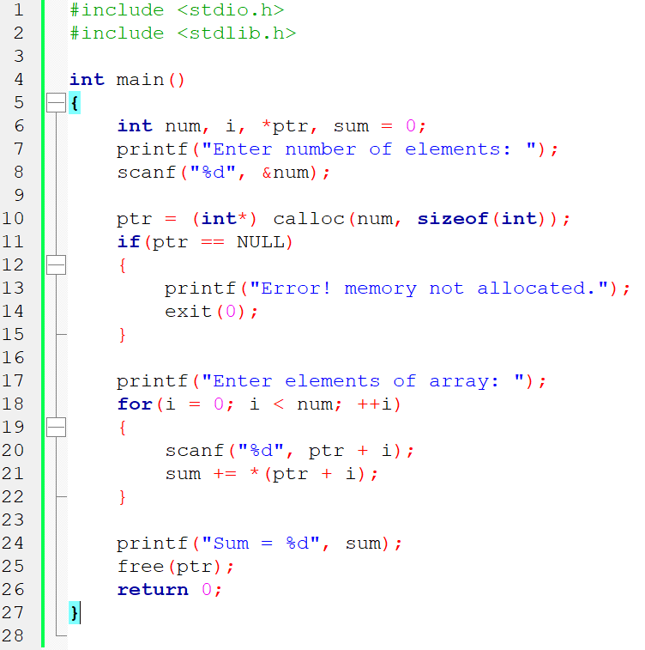
Example of calloc(),free()

Slide 11
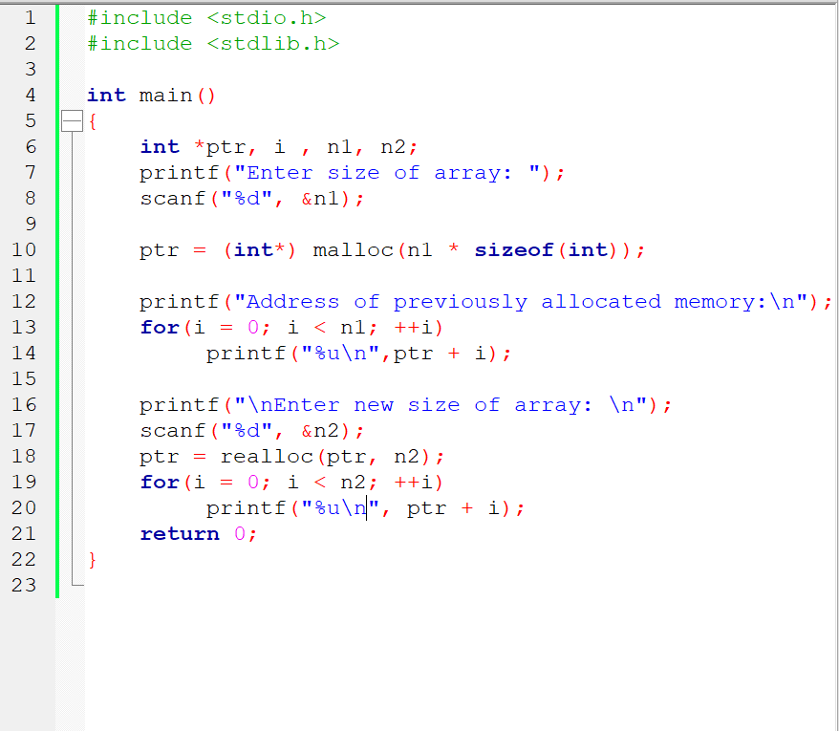
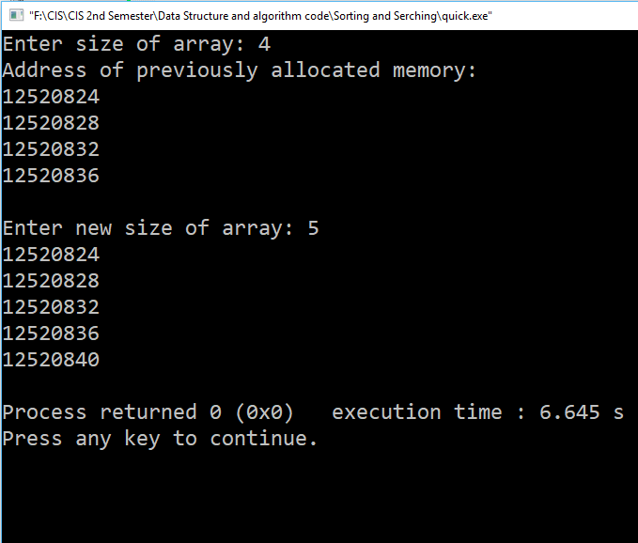
Example of realloc()

Slide 12
malloc() vs calloc()
malloc() stand for Memory allocation and calloc() stand for contiguous allocation
malloc() takes one argument that is, number of bytes and calloc() take two arguments those are: number of blocks and size of each block.
** Storage is Initialize to zero in calloc() but not in malloc().Let’s an example …...

Slide 13
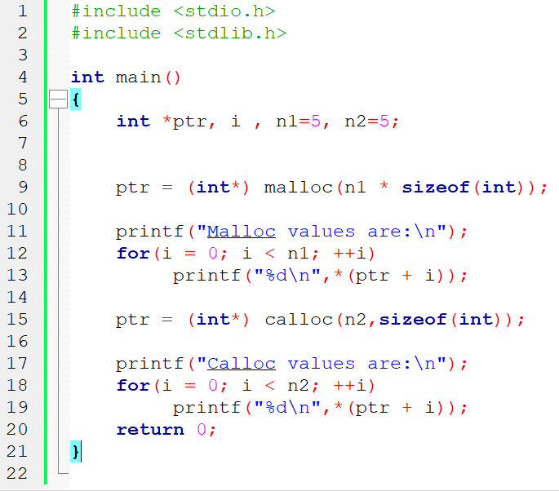
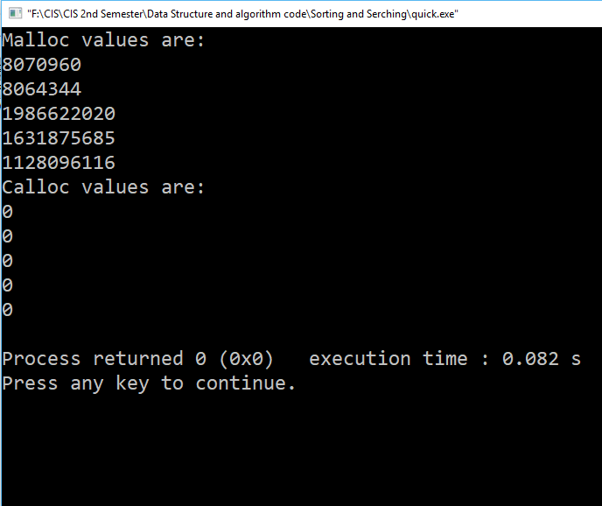
malloc() vs calloc()

Slide 14
Dynamic Memory allocation vs Static memory allocation
Limitation of Static Memory allocation
a) Use stack memory
b) Allocate size during compile time
c) Size is fixed (In a array) and not changeable
d) There is no Memory reusability
Advantages of Dynamic Memory Allocation
a) Use heap memory
b) Allocate size during execution
c) Size can be reallocated/resized
d) There have Memory reusability

Slide 15


